Slide 1


CMPE 202
Software Systems Engineering
Final Presentation & Demo
Avengers – The Game
Notes:
Hello everyone/ Good Afternoon everyone,
Welcome to Project Final Presentation and Demo 1 !

Slide 2

MEET THE TEAM
>> Huy Vo
>> Mangesh Tak
>> Prateek Sharma
>> Kalikalyan Dash
>> Sricheta Ruj
Notes:
> Meet the team
> Project Design Overview
> Features Planned
Early Results
‘> Current Impediments
> Project Schedule(Tentative)
> Individual Team Member’s Role

Slide 3
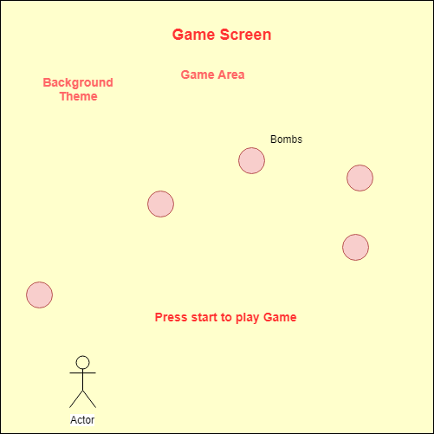
UI WireFrames

Slide 4
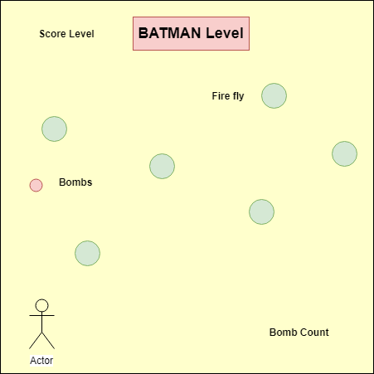
UI WireFrames

Slide 5
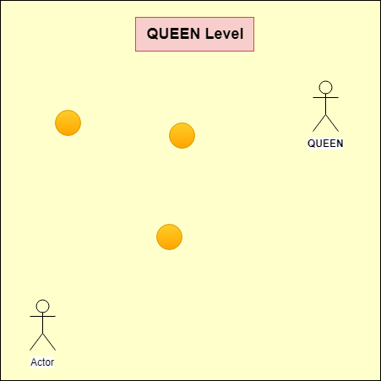
UI WireFrames

Slide 6
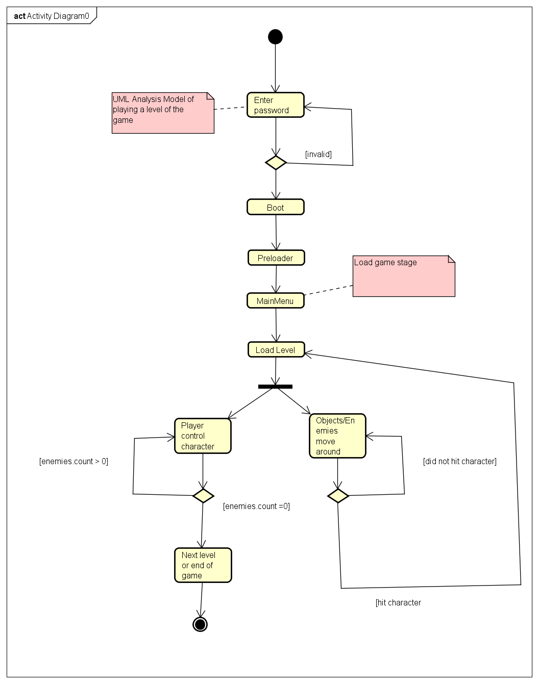
Activity
Diagram
(Flow of loading level 1)

Slide 7
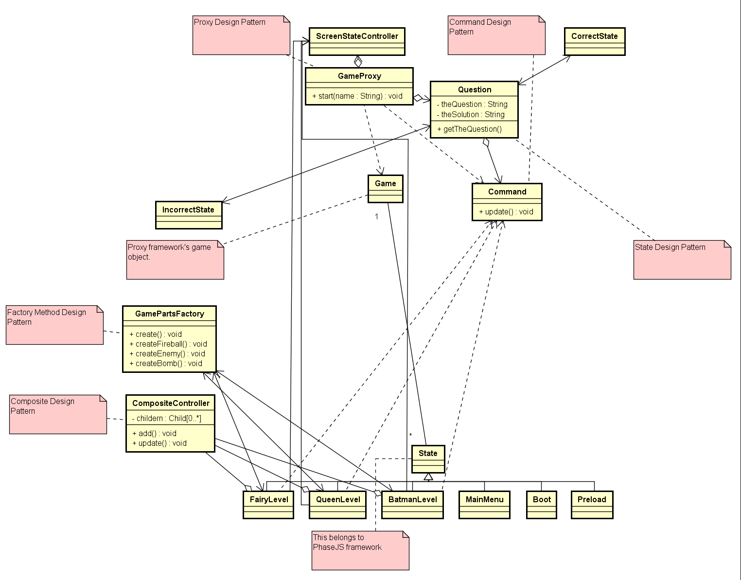
Removed operations + attribute for simplicity
Class
Diagram

Slide 8
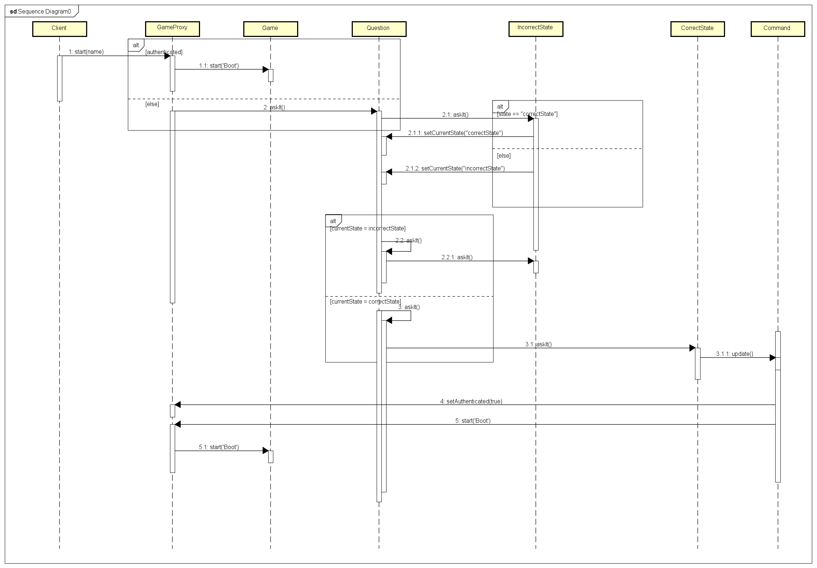
Sequence Diagram of proxy

Slide 9
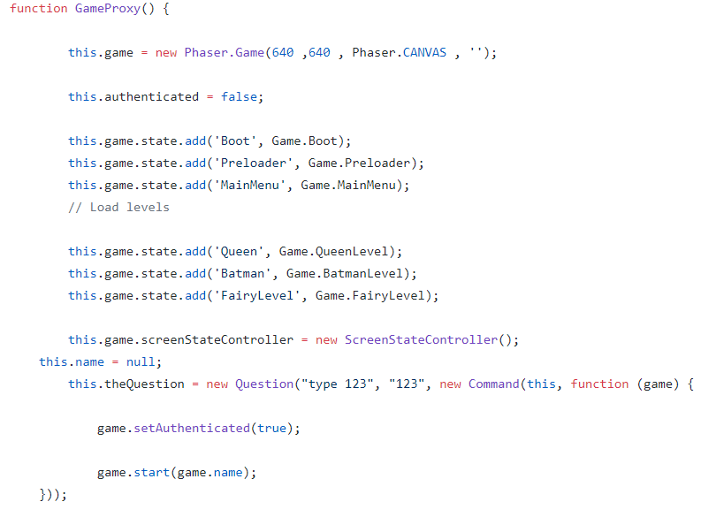
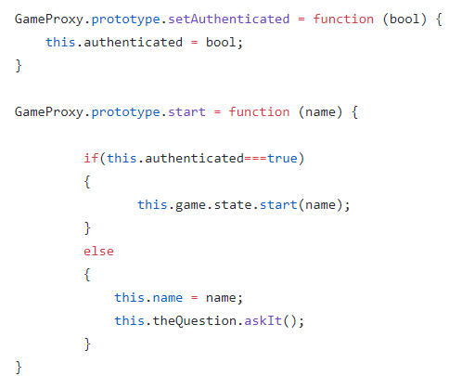
Design Patterns Implemented
>> Proxy – Trivial authentication example
Command Pattern
<-- State Pattern

Slide 10
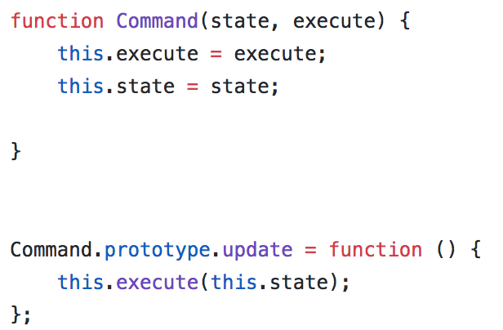
Design Patterns Implemented
>> Command – executing a function base on the given state

Slide 11
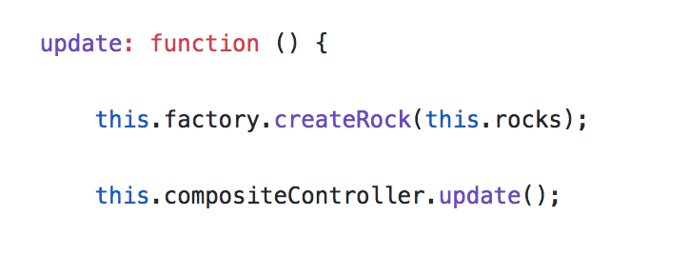
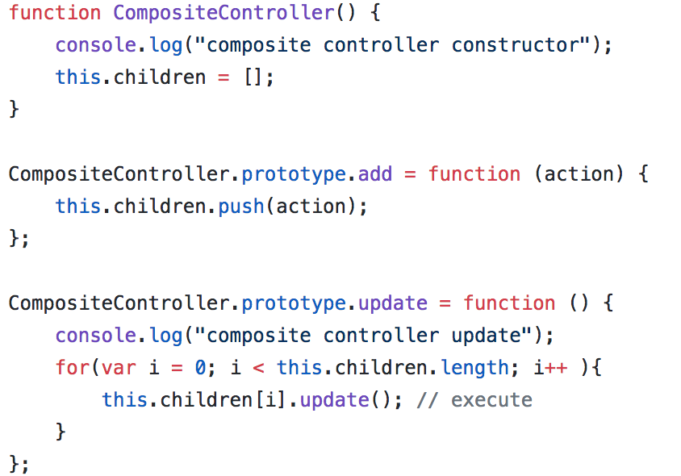
Design Patterns Implemented
>> Composite – Add an action and update the actions and state of game uniformly

Slide 12
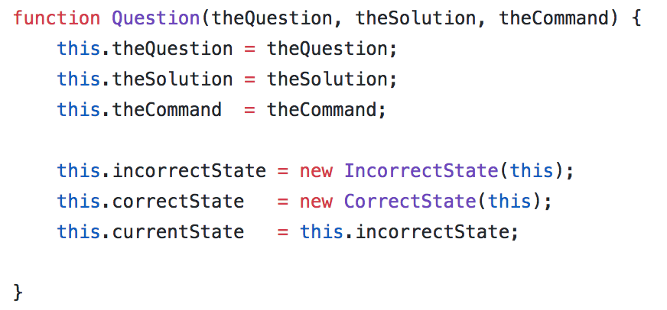
Design Patterns Implemented
>> State – Maintaining the state of question being asked

Slide 13
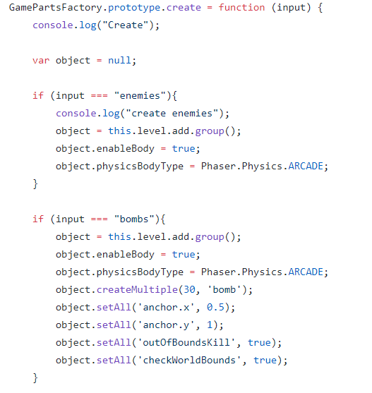
Design Patterns Implemented
>> Factory – Construct enemies, obstructions, bombs and bullets

Slide 14
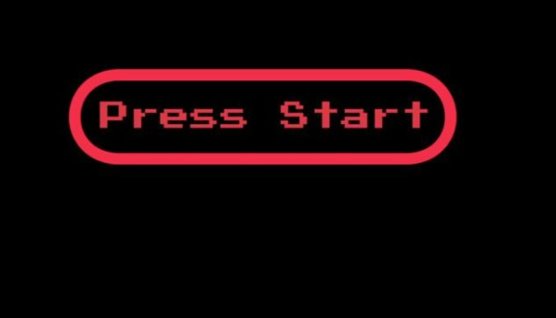
Game Snapshots

Slide 15
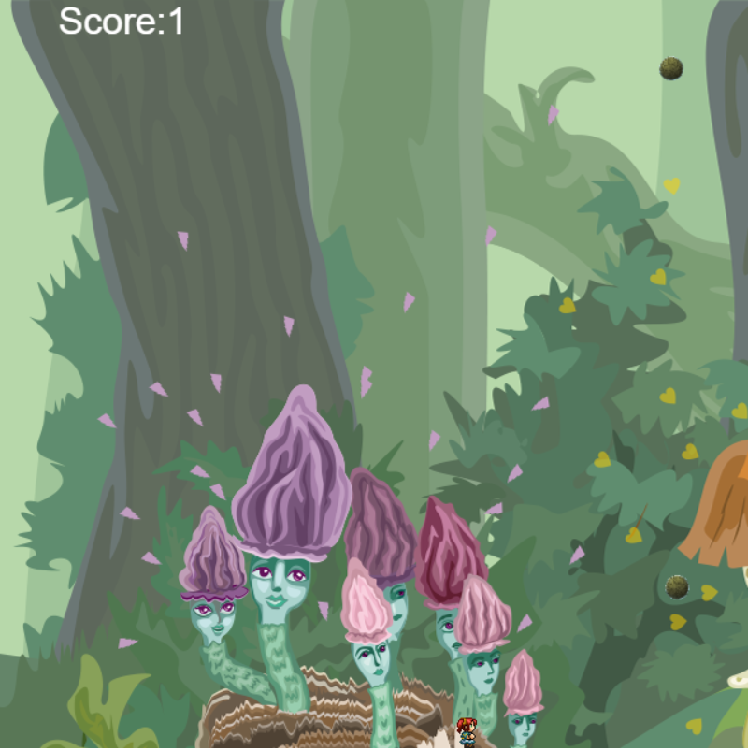
Game Snapshots

Slide 16
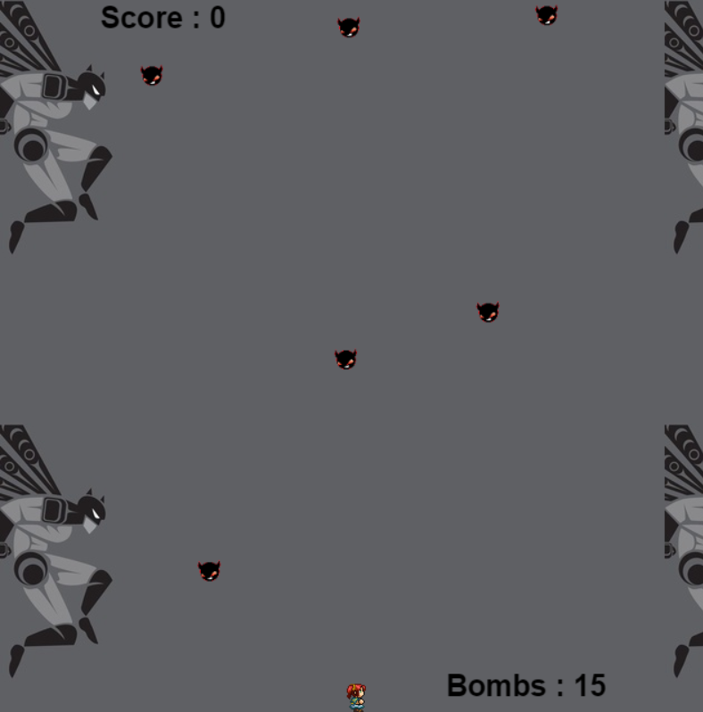
Game Snapshots

Slide 17
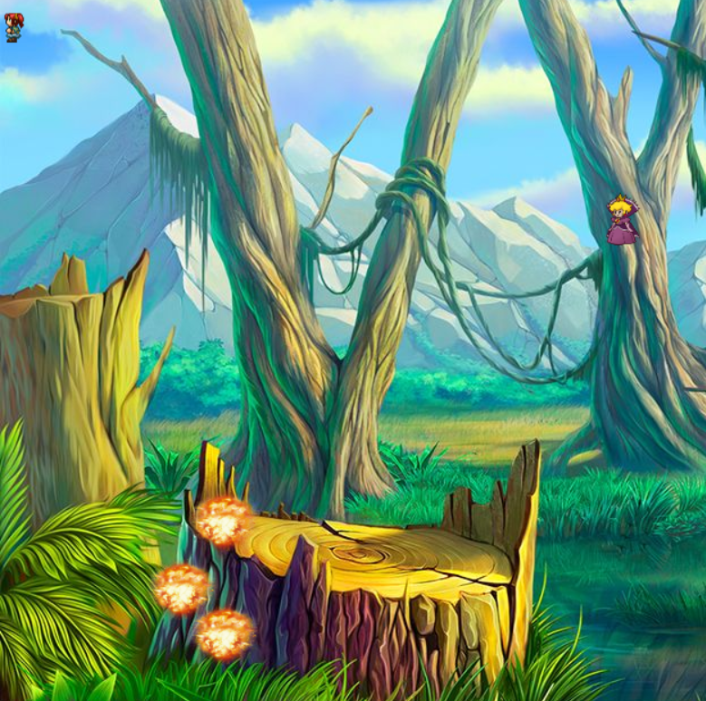
Game Snapshots

Slide 18
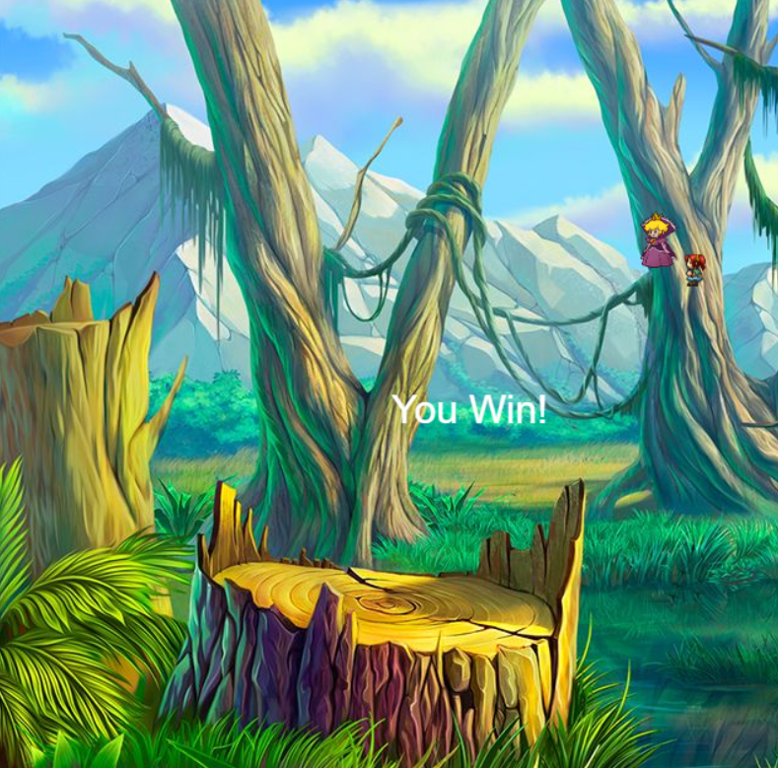
Game Snapshots

Slide 19

Game Live on Heroku
http://boringpeople.herokuapp.com
T.H.E E.N.D

Slide 20
Thank You
T.H.E E.N.D

